Slide 1
AGORA

Slide 2
What does Agora offer?
it offers exciting adventures and lifelong experience to all age-groups
Play and entertainment are combined with learning in Agora
And may be part of unique and spectacular experiments.
In the laboratories of the three-storey modern building the visitors can gain insight to the miracles of physics

Slide 3
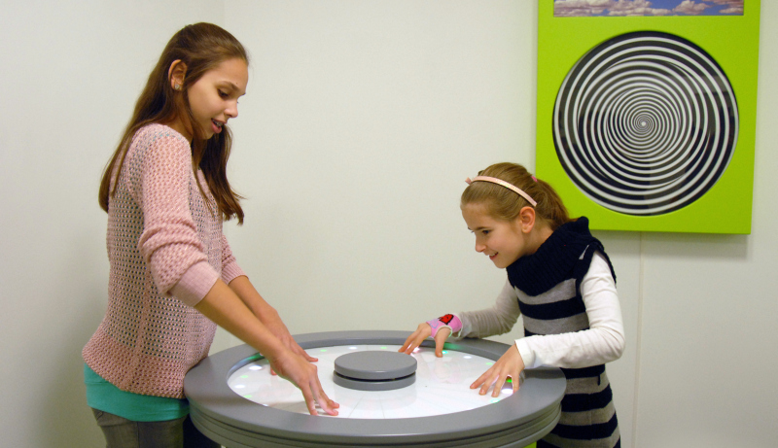
Visitors may try more than thirty scientific games and instruments in the interactive space
Scientific games

Slide 4
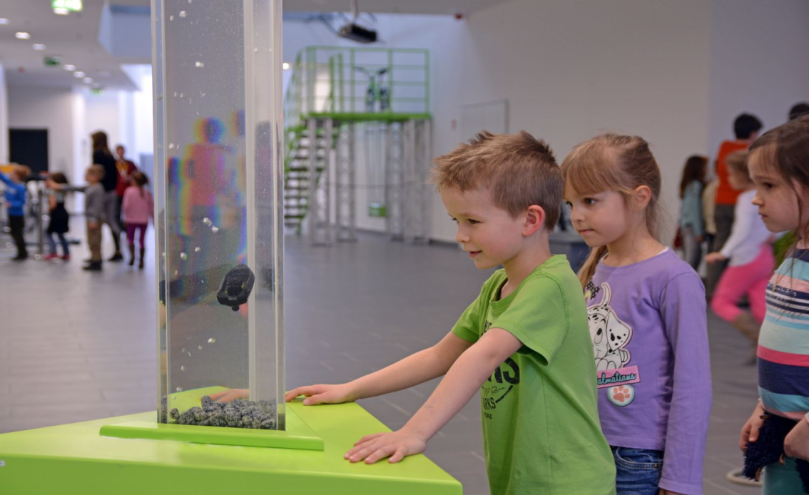
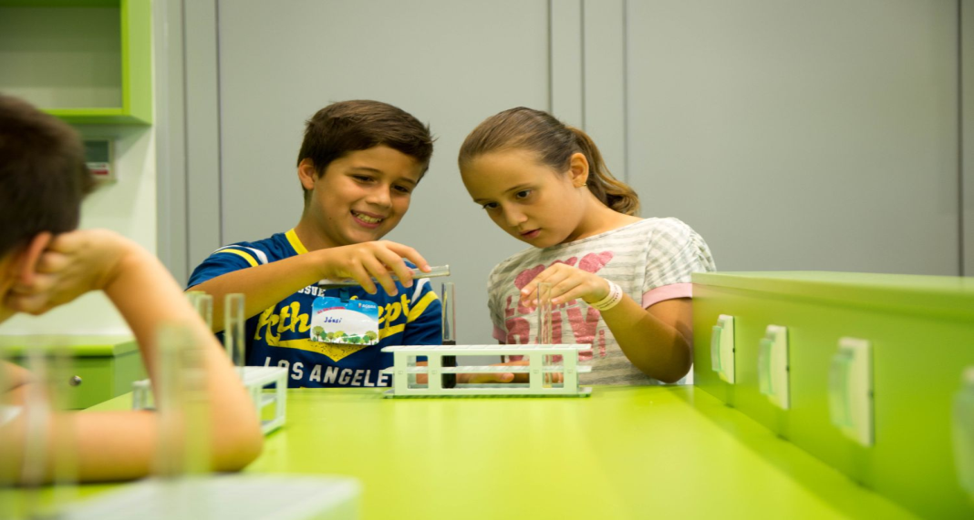
It offers exciting adventures and lifelong experience to all age-groups
They offer interesting lectures, film screenings and other colourful programmes in Agora.
one may always learn something new at Agora.

Slide 5
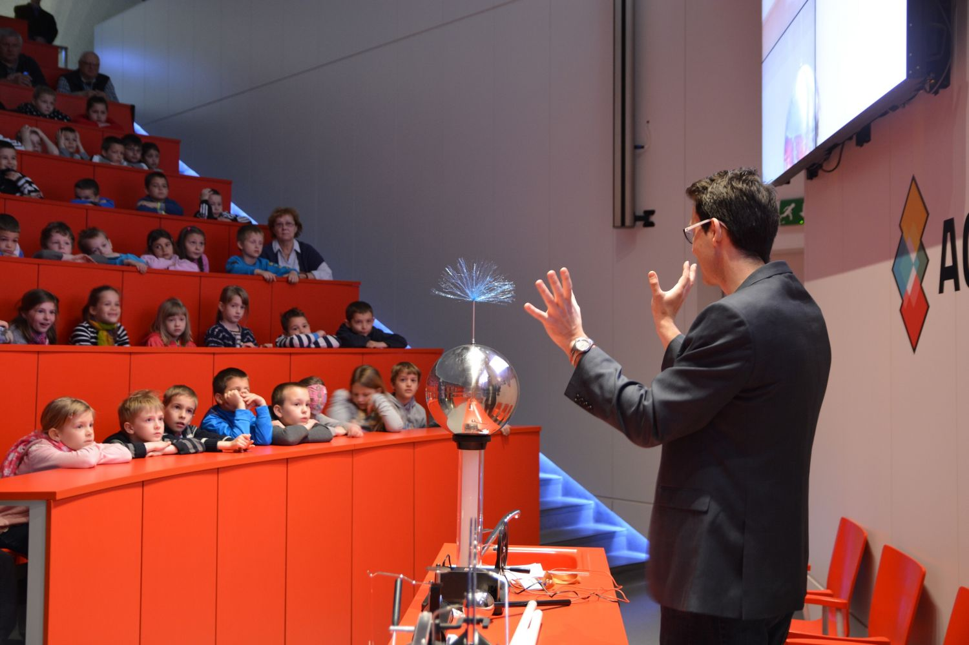
The centre is a huge colourful classroom; they give space for school groups’ special classes and experiments to turn learning into experience.

Slide 6
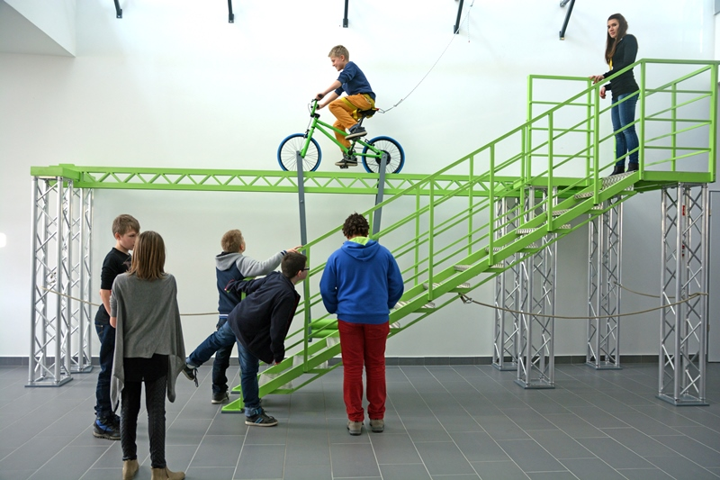
YOU CAN TRY YOURSELF IN LOT OF INTERACTIVE GAMES
Bicycle in the Height
Sit on the bicycle and ride out!
You don’t need to be afraid, the little vehicle stays stable!

