Slide 1
H-angol-J a munka világára application American English Corner Debrecen
16th November, 2016.

Slide 2
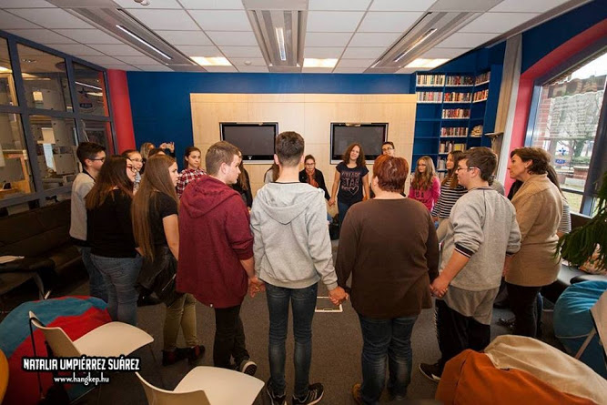

Slide 3
The American Corner’s Program is a United States Department of State-sponsored initiative inaugurated worldwide more than 10 years ago. Since 2000, the U.S. has launched almost 400 American Corners in approximately 60 countries.

Slide 4
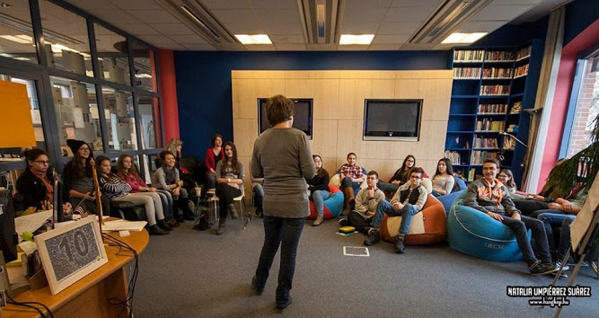

Slide 5
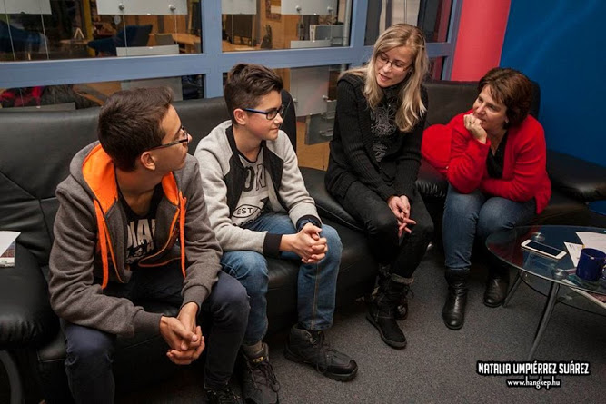
Operated as partnerships, the U.S. provides equipment and materials while host institutions provide staffing and the free use of space.

Slide 7
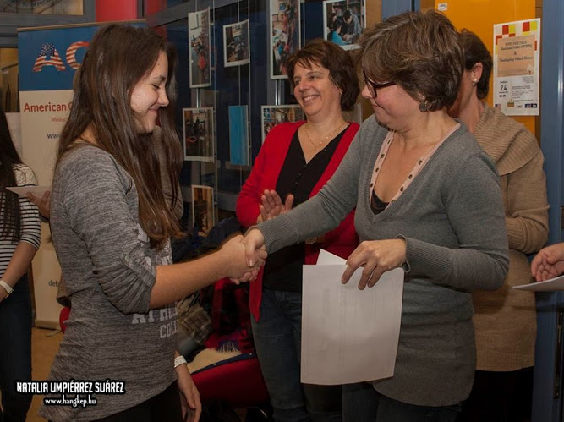
In the end everyone got a certificate

