Slide 1
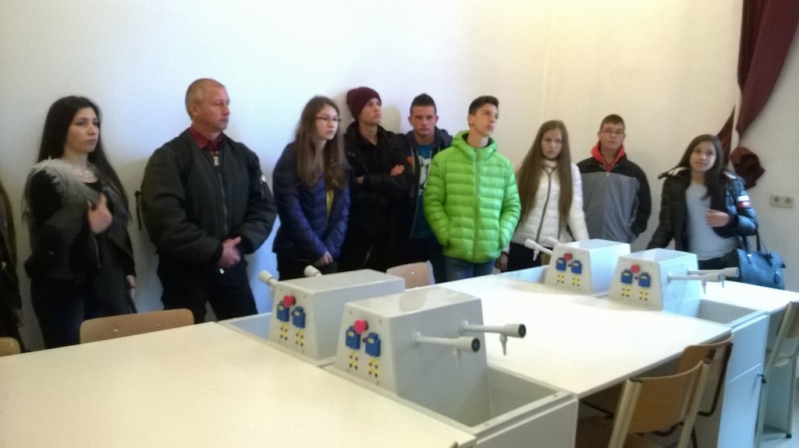
Budapest Trip

Slide 2
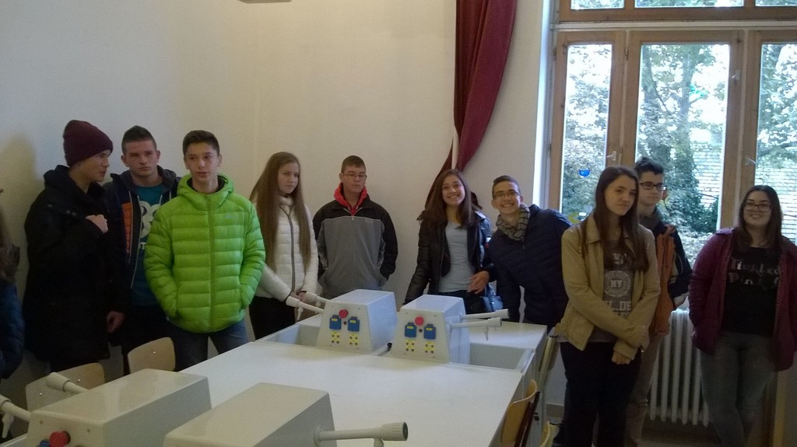
H-angol-J a munka világára
As a first station of our career orientation application we travelled to Budapest. The study trip had a dual purpose. We participated in a sightseeing tour in the city, which was not accompanied by a tour guide, but we introduced the sights of the capital in English, which was also taken on a film.

Slide 3
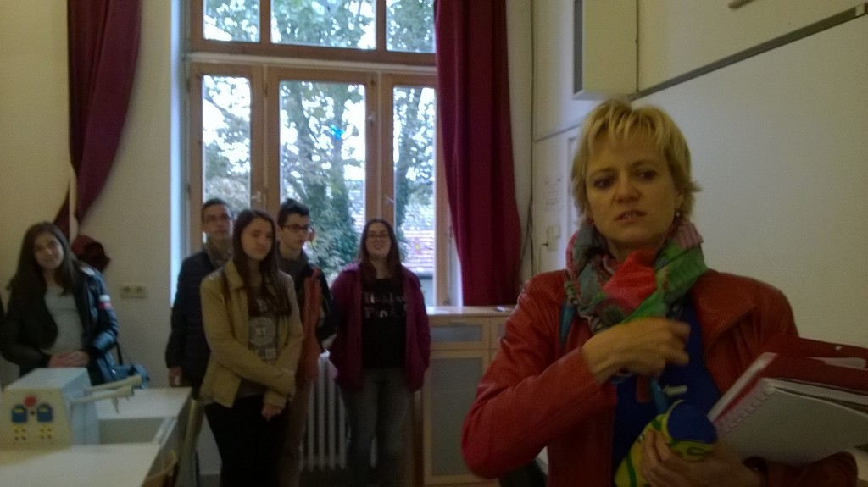
Before our trip our teachers invited an American guest Jennifer SalisburyPrior to our trip, the students invited an American guest lecturer Jennifer Salisbury director held a lecture and a workshop on the importance and mission of tourism, as well as on her experiences in her life.

Slide 4
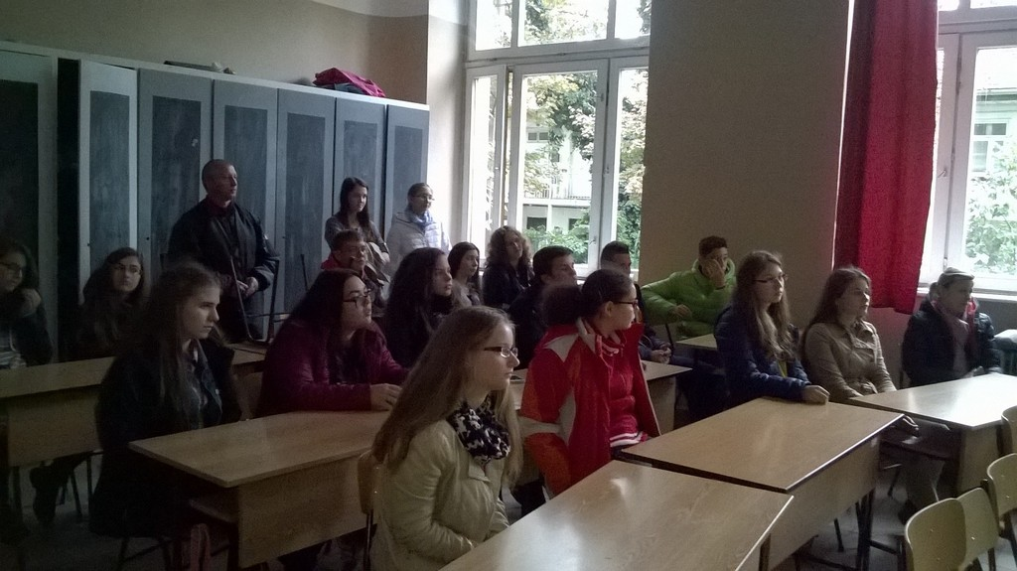
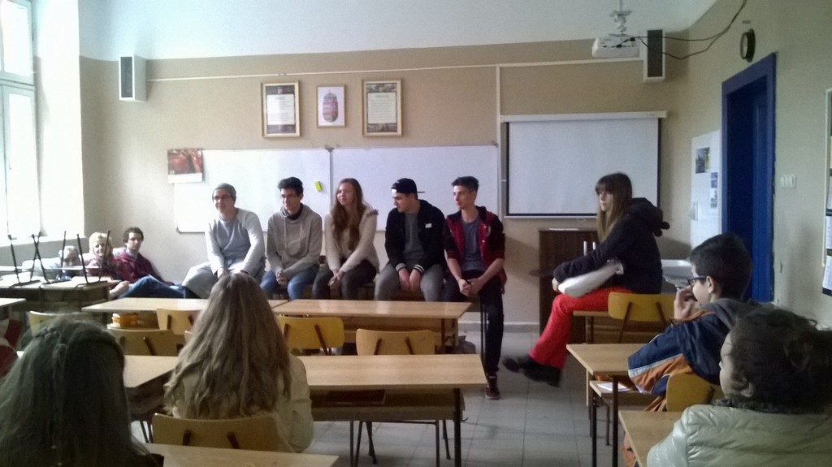
Students in Budapest interviewed some of the pupils of the secondary grammar school. They said language is learned very quickly and efficiently, as it is practiced at such high doses that knowledge is often obscured.

Slide 5
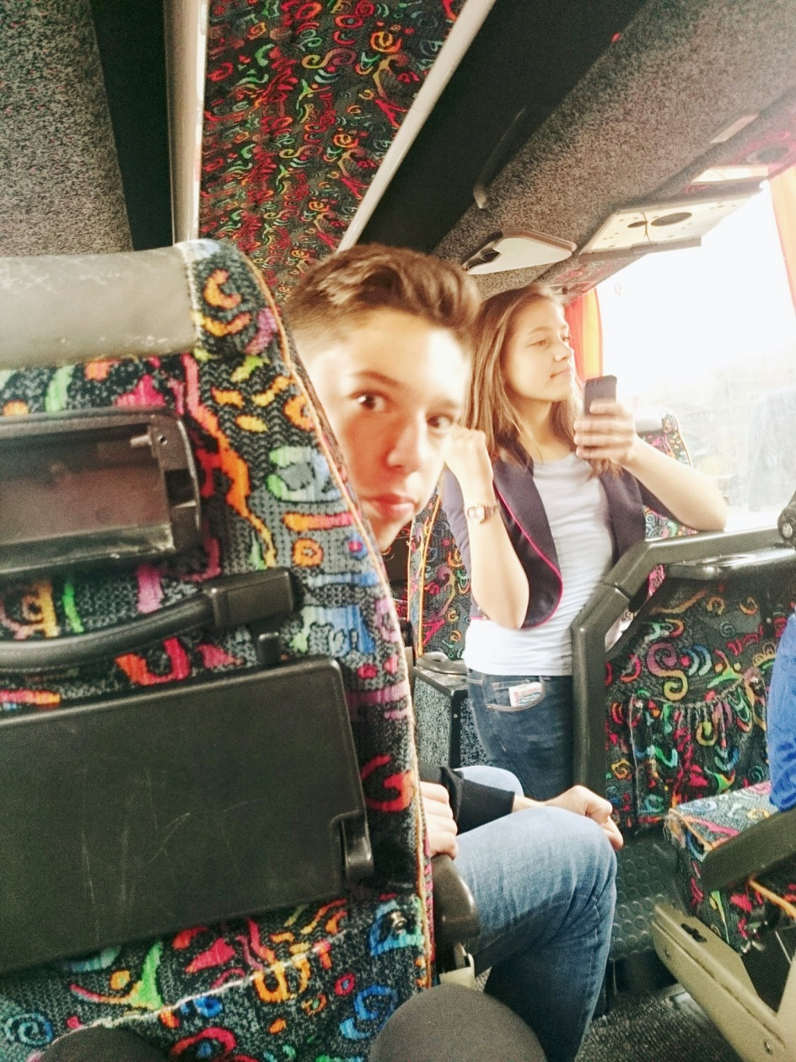
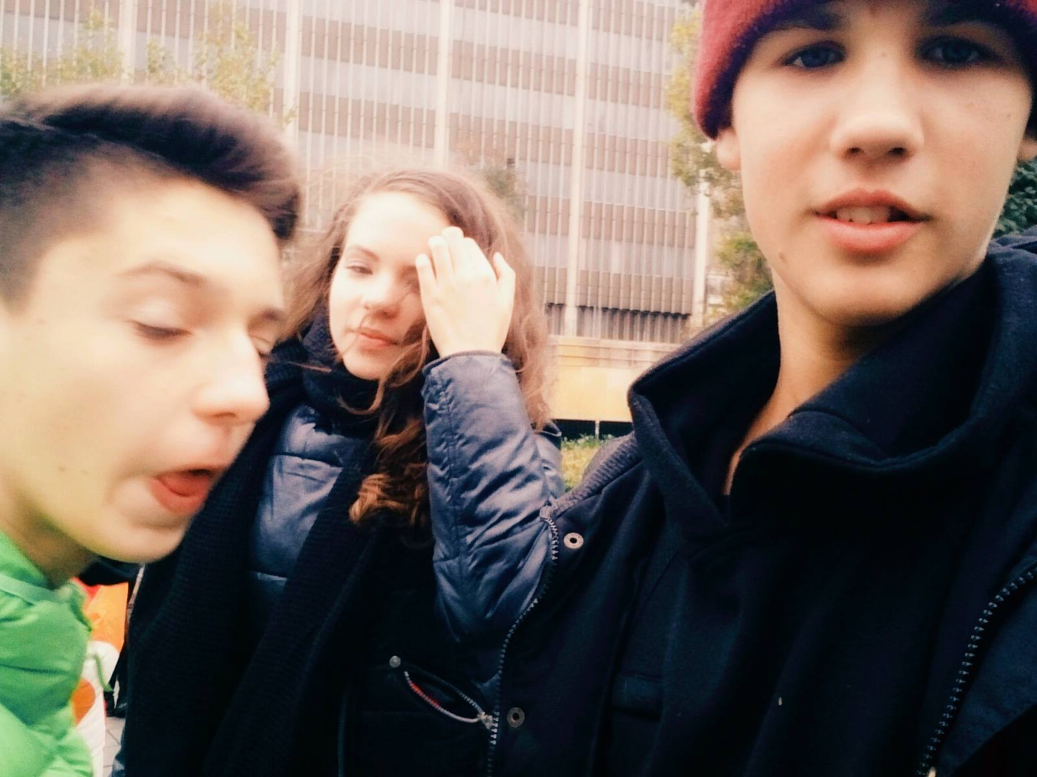
The study trip gave a lot of experiences for both students and teachers. We are pleased to have the opportunity provided by the application for us. Certainly, many people are fond of finding their aims in the future, whether in tourism, or in the catering industry.

