Slide 1
IT services

Slide 2
In May, 2017. we visited IT Services in Debrecen. All of us were born into a developed, modern world so it was a very interesting experience to see how this organisation works. There is a huge building which is suitable for all needs, and there is also a big car park.
People seemed to arrive at work with pleasure.

Slide 3
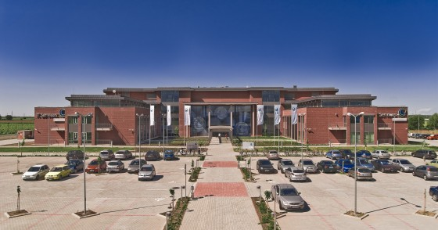

Slide 4
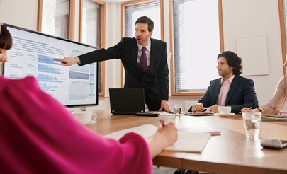

Slide 5
We loved to see cooperation of the employees. People have a good sense of information technology and they speak foreign languages well.

Slide 6
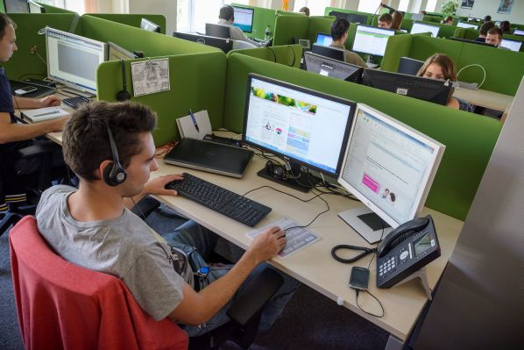
The employees speak mainly English and German.
Each of them gets from the firm 120 free lessons to develop their foreign language.

Slide 7
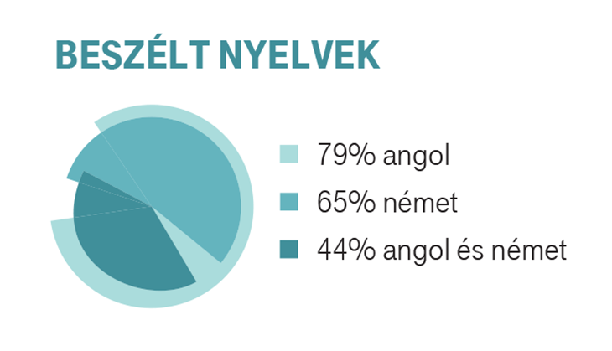
79% of the workers speak English, 65% speak German and 44% speak both English and German.

Slide 8
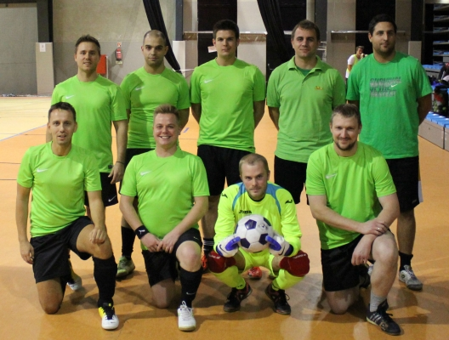
Besides daily work people can do different sports. IT Services has got an own gym. Employees also can go to work by bike.

