Slide 1
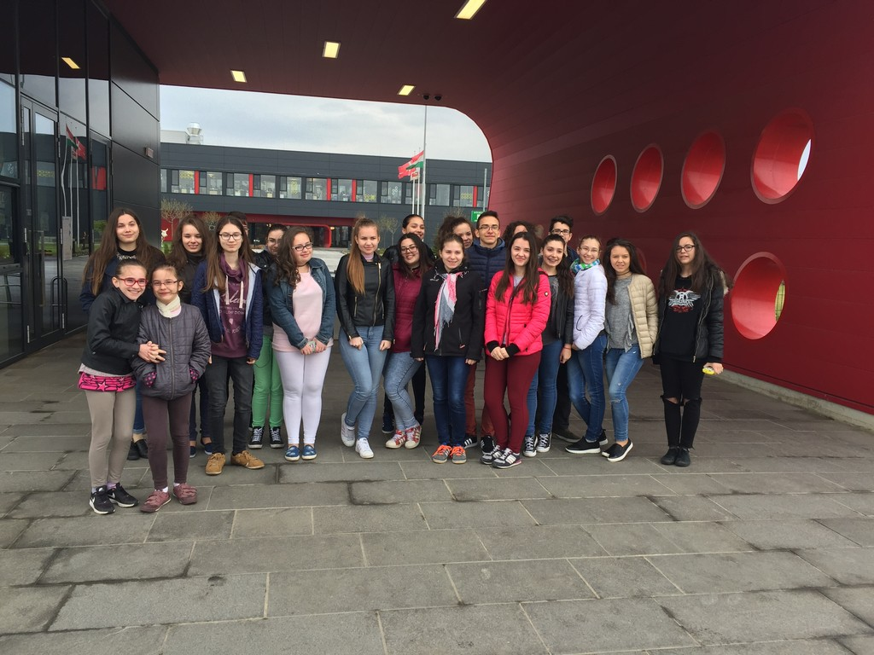
LEGO Nyíregyháza

Slide 2
On April 13, 2017, H-English came to another milestone in the world of work! . As a result of extensive organization and consultation, we have been given the opportunity to view the LEGO Group's open-air facility. Despite the fact that our journey fell on the first day of the spring break, 21 students and accompanying teachers were enthusiastically prepared for this program, as it is very difficult to get to the factory after an average of one and a half years after waiting time.
In the framework of the project, children's English language skills are evolving by encompassing various topics. Prior to the visit of the LEGO Factory, we worked on words and phrases related to professions and workplaces. We have sorted the personality traits necessary for each occupation, and we got acquainted with their English equivalents. In our lessons we talked about the advantages and disadvantages of the various professions and the difference between skilled and trained work.

Slide 3
After the English language development, our students gained experience from real life. At the beginning of our factory visit, we learned that Nyíregyháza is one of only five LEGO factories in the world, and the plant is not only ultra-modern and environmentally friendly but also reflects the world of LEGO games.
The Nyíregyháza unit was established in 2008, and since 2014 it has been building a new building, in the most modern environment and in increasing quantities, everybody's favorite building game. The name of the brand comes from the Danish "Leg godt!", Which means "Play well".
After a brief briefing we got a protective jacket and we could see the units. We can see that in Nyíregyháza all stages of the production of LEGO products can be found - from plastic raw materials to finished products packed on pallets. Our guide said that most of the LEGO DUPLO products are manufactured here, but also ready LEGO boxes are being removed from the factory. Here is the largest automated warehouse system in the region - two buildings with its shelf system and robotic cranes are highly symbolized by the use of future-proof technology to optimize their processes.

Slide 4
During our visit, we were able to get an idea of ​​the various vocational training opportunities: In order to provide the professionals with the right skills to produce LEGO cubes in the future, the management of the company has introduced its own training programs. The subject of the automated logistics processes was started jointly with the Budapest University of Technology, where their engineers share their knowledge with the students. By preparing injection molding tools, one-year in-house training can be used to get acquainted with young people with a high school diploma who are admitted to the course.
From the 1930's on, LEGO Group's motto: Only the best can be pretty good. Their goal is to meet ever-increasing demands while guaranteeing the best possible quality.
The Group also places great emphasis on environmental protection, striving to leave as little trace as possible. To this end, a number of technological solutions have been used to build the factory, which can significantly reduce energy use. On top of buildings, rainwater is collected, instead of drinking water for irrigation and other purposes.
At the end of the tour, we were able to relax with the creative LEGO building in the play room, and we were able to enjoy the long walking strokes that our students enjoyed very much. After an impressive visit, during which our students could have been in the world of physical and spiritual work, we could return home with positive experiences.

Slide 5
