Slide 1
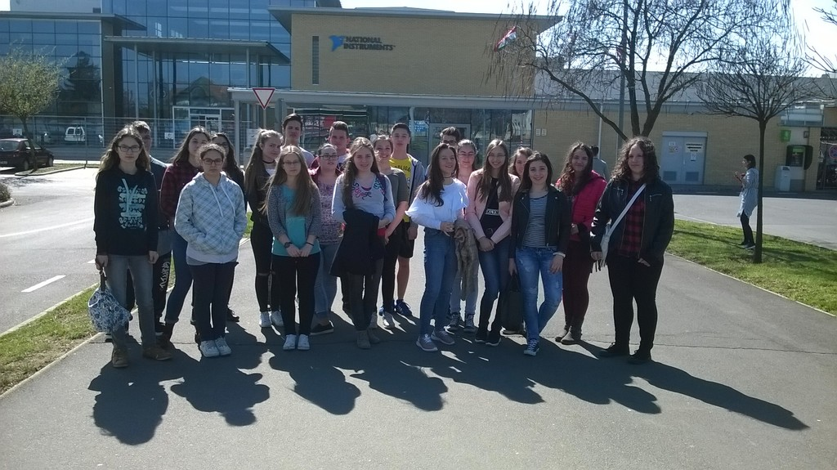
NI-National Instruments
24th of March

Slide 2
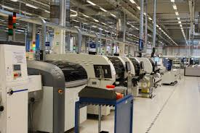
In our application we visited the factory of NI (National Instruments) in Debrecen, also we took a look into the job of an engineer. The workers presented us the production line and the storage.

Slide 3
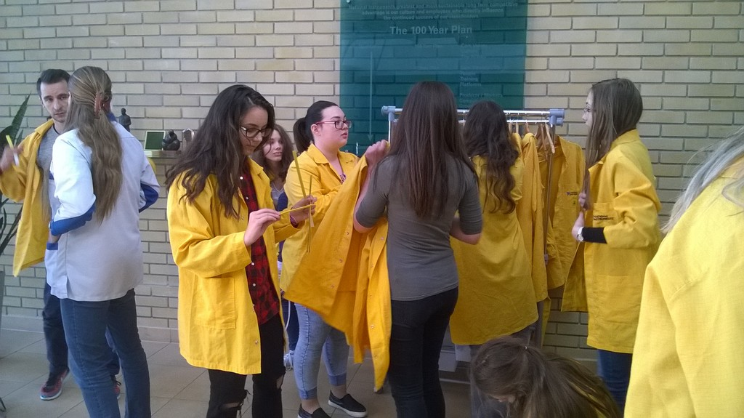
In the beginning of our tour we watched a short film about the ‚evolution’ of NI from the early of the 70’s .
Before we started our trip into the factory part of the building we had to change our clothes to protective clothing .

Slide 4
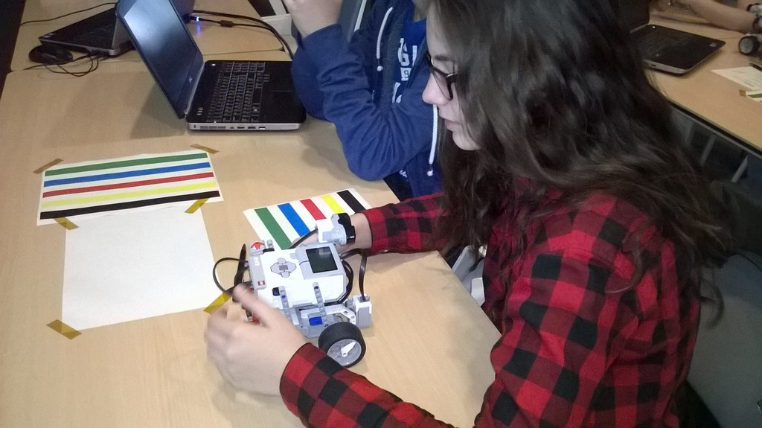
After our tour we went back to the lecture hall where we started to learn programming.
You are going to watch a video on the next page where we tried to programme a Lego robot. (It was very interesting and exciting for me :D)

Slide 5
We „played” with Lego robots wich are used to teach children and people about programming.
It was a great fun!

Slide 6
Thank you for your attention!
Made by: Hegedüs Bence

