Slide 1
Disszemináció az Erasmus + Let‘s take a CLIL Leap – pályázat előrehaladásáról Dissemination of Erasmus + Let‘s take a CLIL leap – progress report
School/Country: II. Rákóczi Ferenc Magyar – Angol Két Tanítási Nyelvű Baptista Általános Iskola és AMI, Hungary Date and place of presentation: Téglás, 25th September 2017.

Slide 2
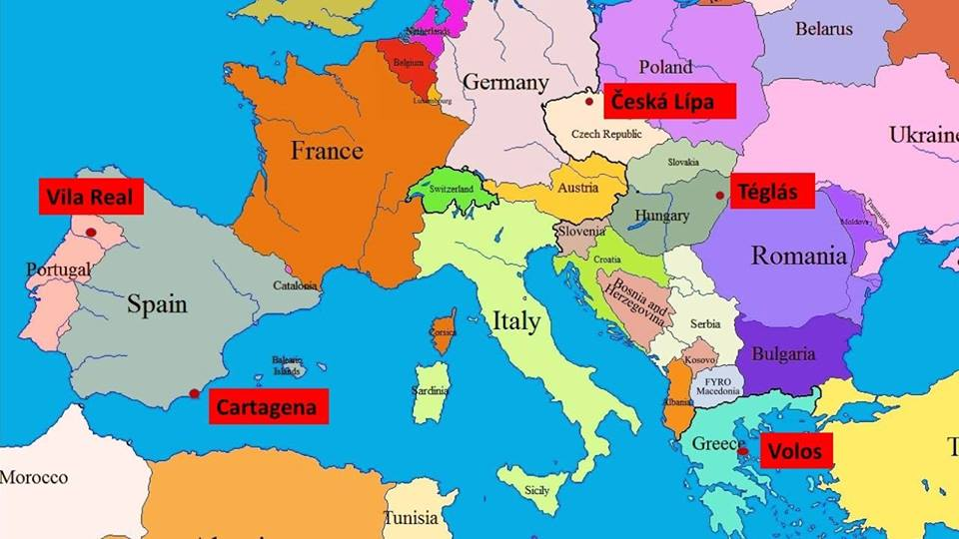
Dear Partners! Welcome to Hungary!

Slide 3
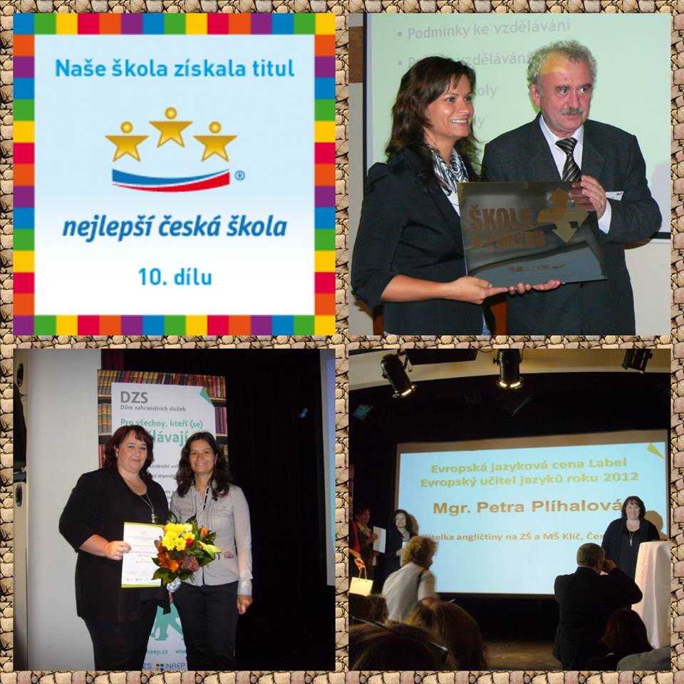
The coordinating school of this project: Skola Klic International coordinator: Petra Plíhalova

Slide 4
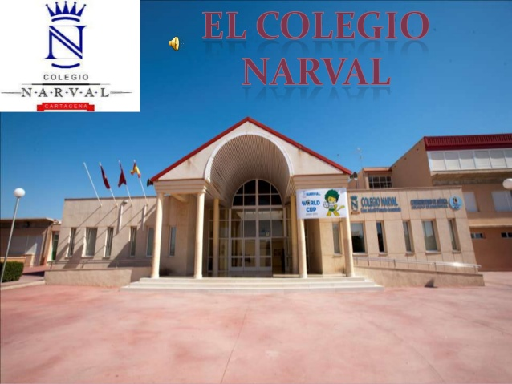
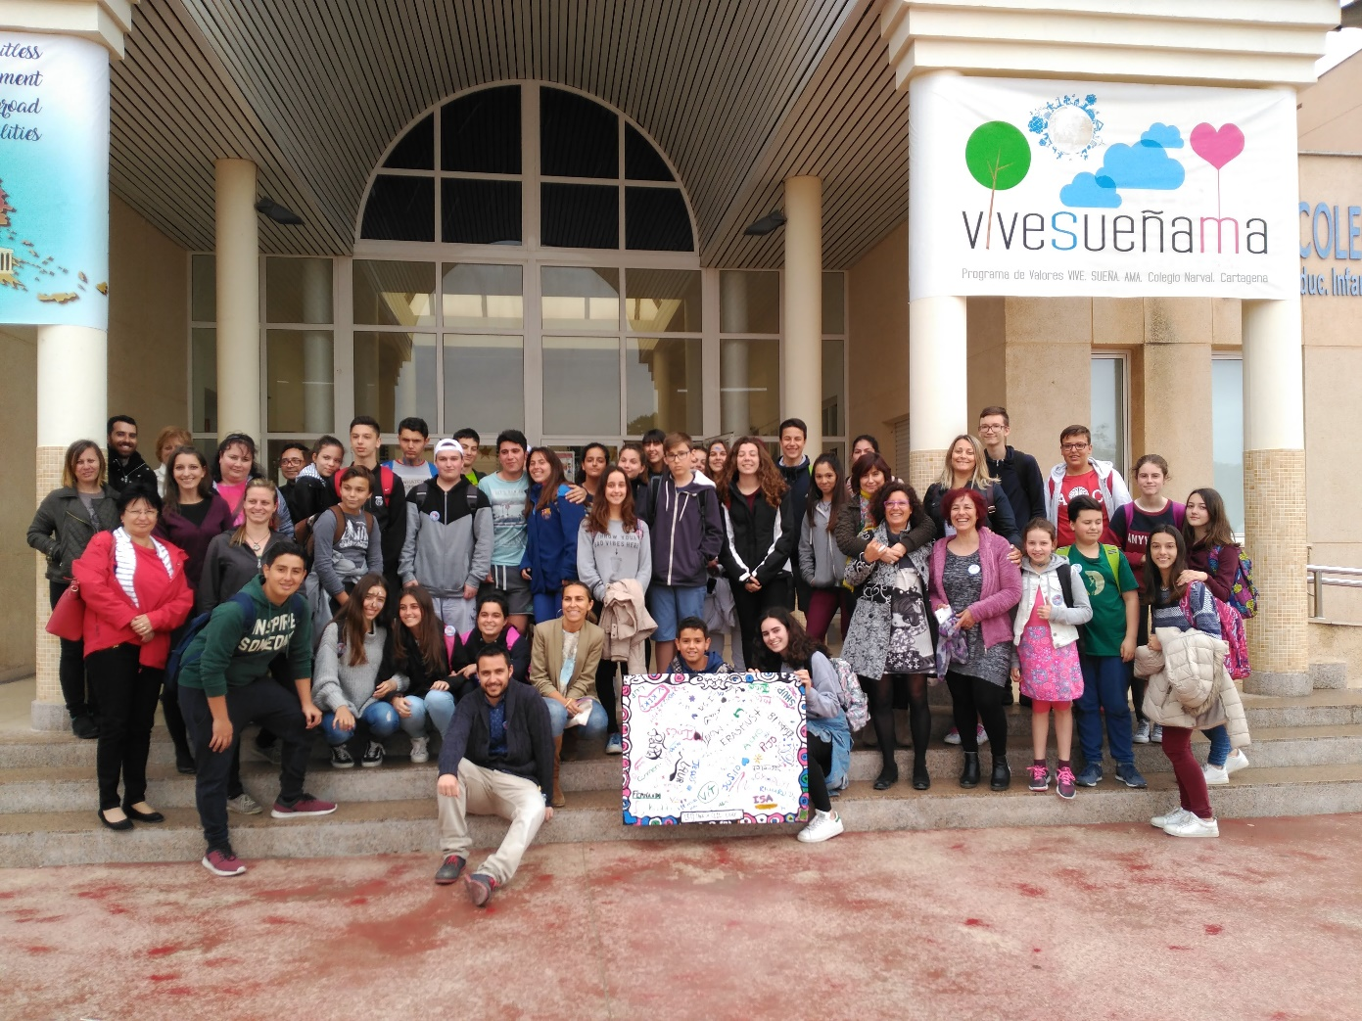
Colegio Narval, Cartagena - Spain

Slide 5
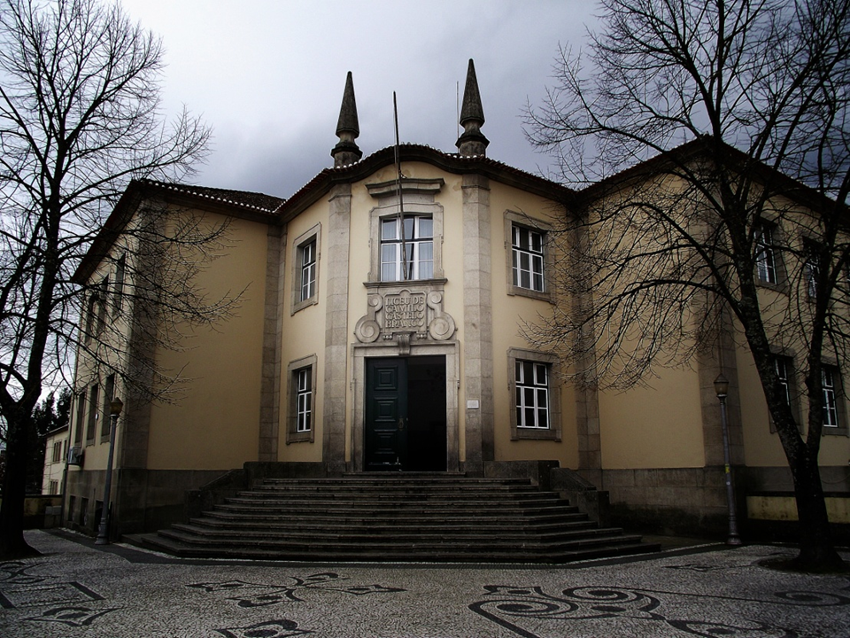
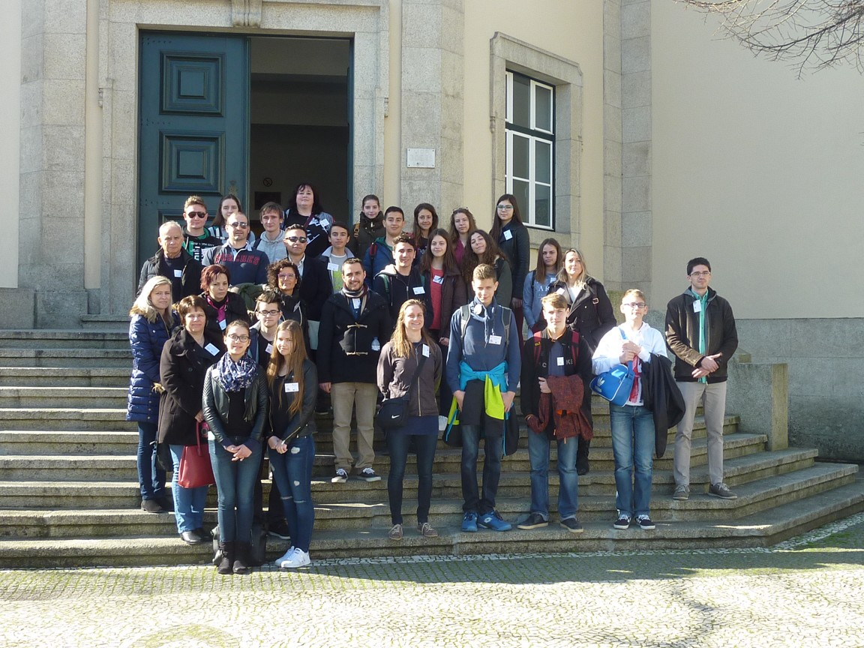
Escola Secundária/3 Camilo Casstelo Branco, Vila Real - Portugal

Slide 6
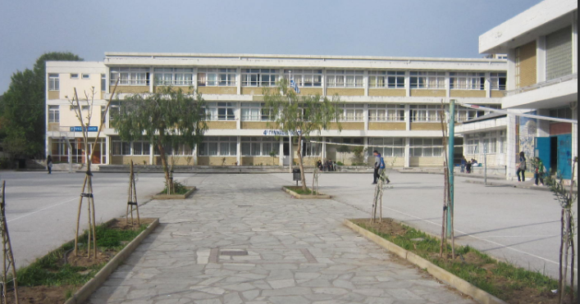
4th Gymnasium Volos - Greece

Slide 7
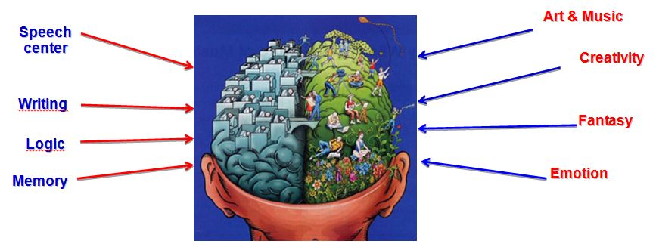
We came together with the idea to develop innovative practices in both foreign language teaching and learning.

Slide 8
Language
Language is the process by which all human beings transmit, communicate or express their thoughts, opinions and ideas; in some other way using all the senses through speech, writing, signs or symbols, given the understanding as a fundamental aspect of language. Language is one of the most important in the life of human beings elements.

Slide 9
Learning
Learning is one of the main functions that uses the mind of human beings, as this process involves obtaining the knowledge, skills, virtues, values and attitudes that characterize everyone. This acquisition process is possible through study or training taht is part of the process, and even the experience you gain from any walk of life.

Slide 10
Teaching
Teaching besides being one of the most important and fundamental functions of the school, it is one of the activities and practices that humans develop. This practice involves the development of methods which everyone uses in order to pass on their knowledge, beliefs, values, customs or specific information to another person or group.

Slide 11
First transnational meeting in the Czech Republic: Ceska Lípa

Slide 12
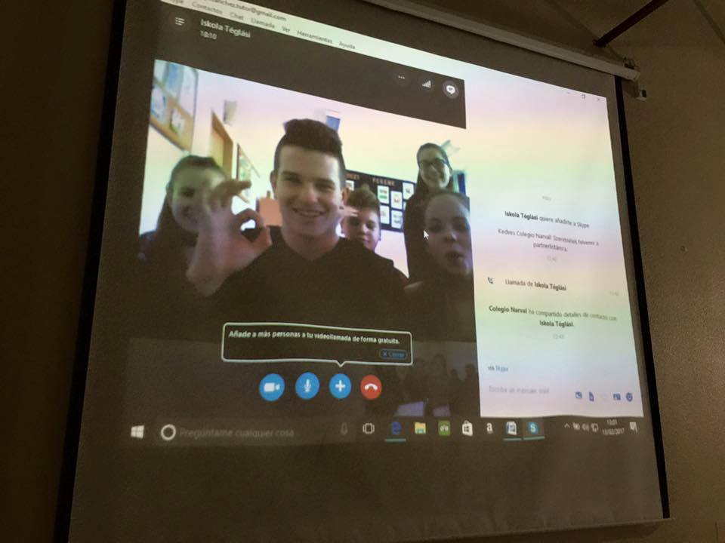
Chatting and Skyping with the Partner Students

Slide 13
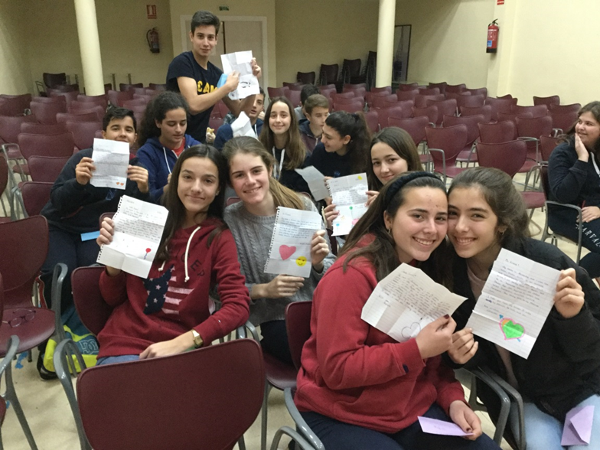
Having Pen-Pals: Spain - Hungary

Slide 14
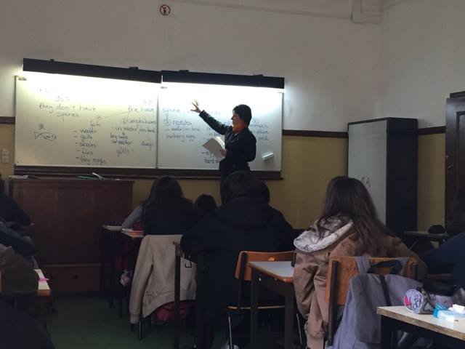
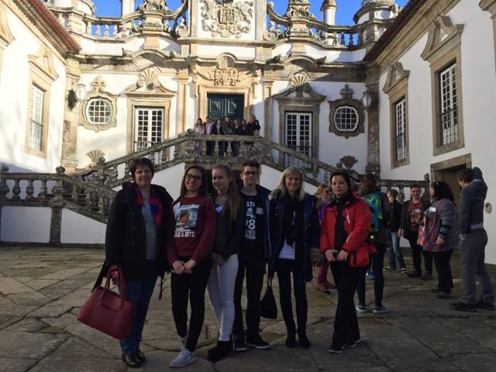
First mobility: Portugal: Vila Real

Slide 15
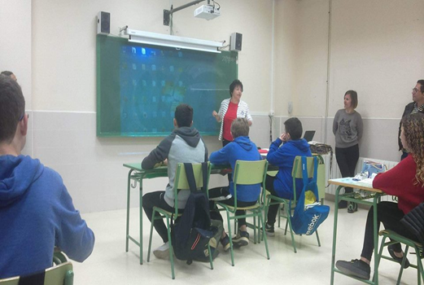
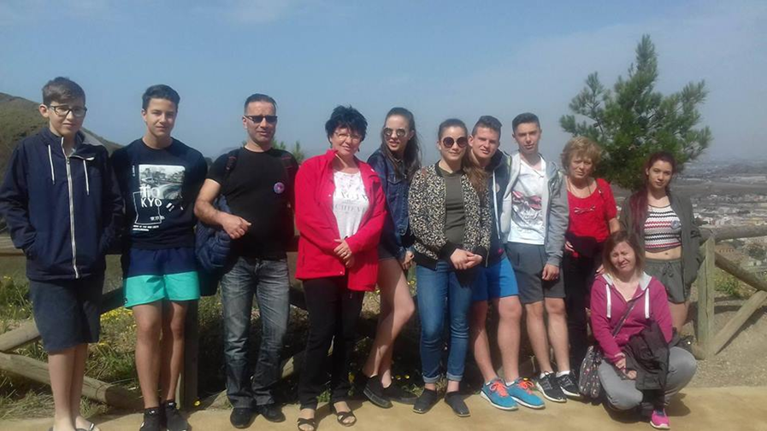
Second Mobility: Spain - Cartagena

Slide 16
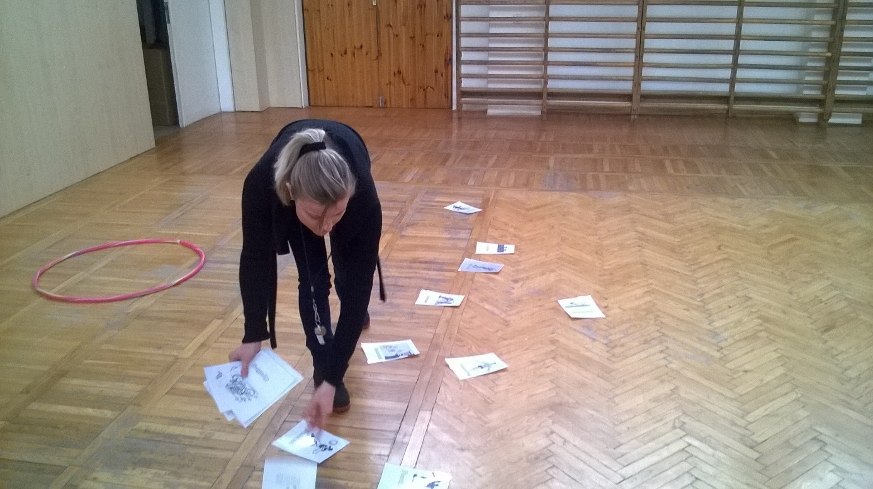
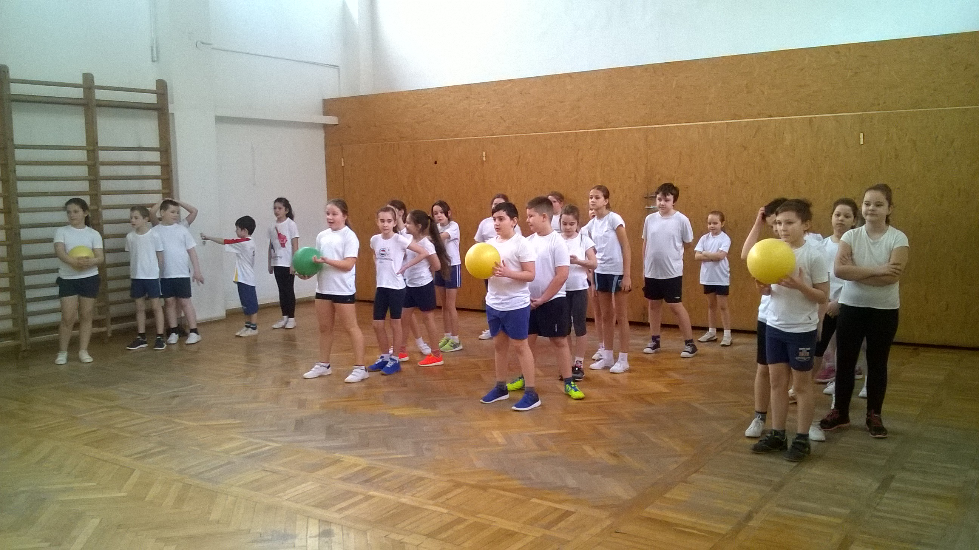
PE – using the lesson plan of Spain

Slide 17
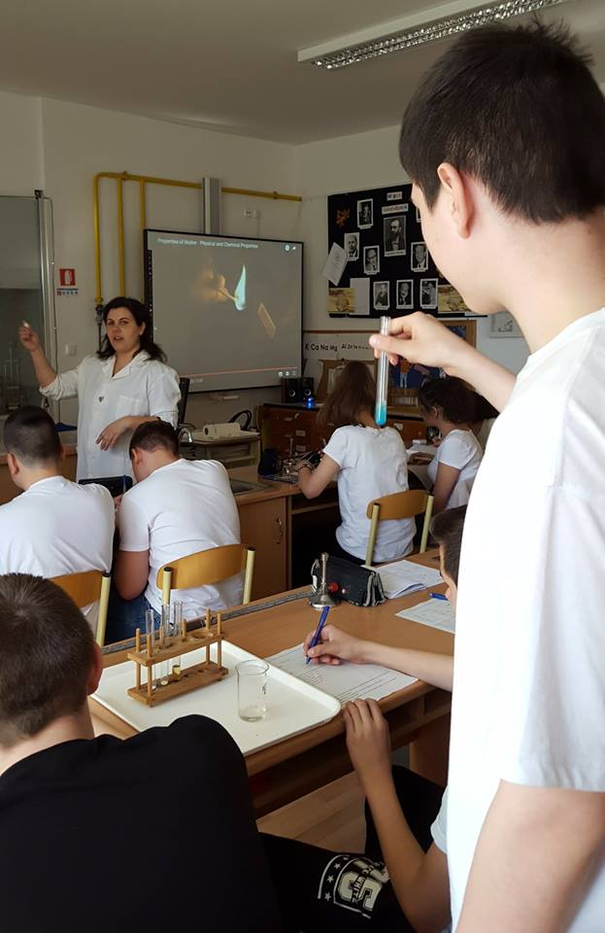
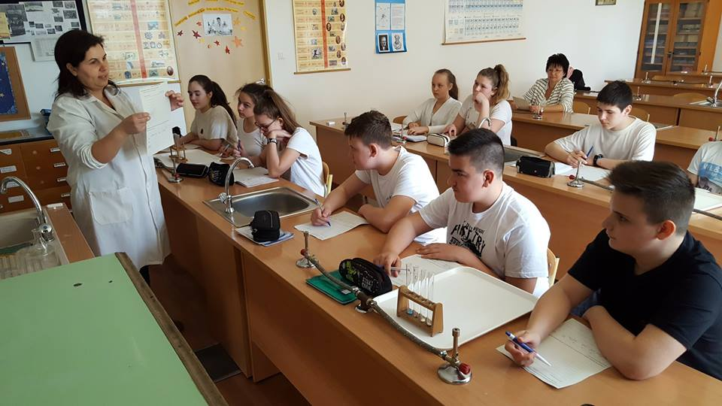
Chemistry: Observing Physical Properties

Slide 18
Sources for used materials:
http://firstandsecondlanguageacquisitionunad.blogspot.huSource 1

