Slide 1
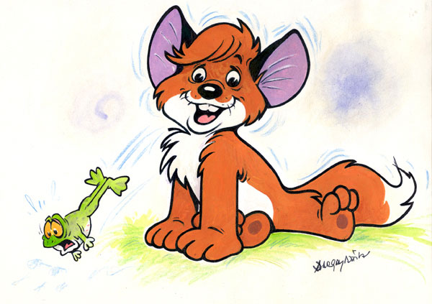
The Little Fox

Slide 2
1981 Hungarian animated film
Based on the novel Vuk by István Fekete
One of the classics of Hungarian animation

Slide 3
The film tells the story of a little fox kit, Vuk, who ventures away from his family's den and, upon his return, learns from his uncle Karak that his entire family has been shot and killed by a human hunter

Slide 4
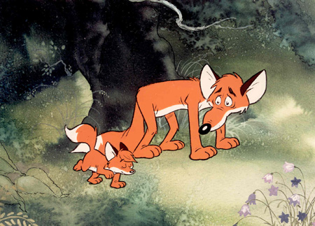
Karak then offers for Vuk to stay with him, and he continues to raise him.

Slide 5
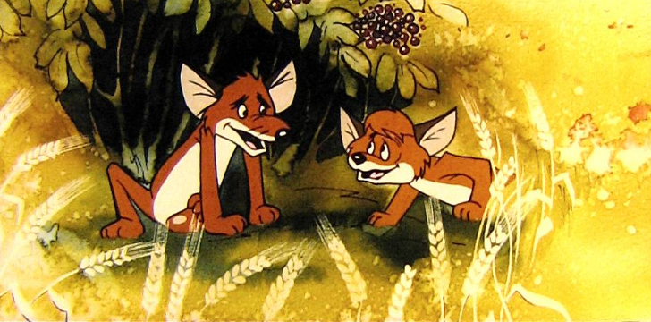
As Vuk grows older, he develops much cunning and cleverness.

Slide 6
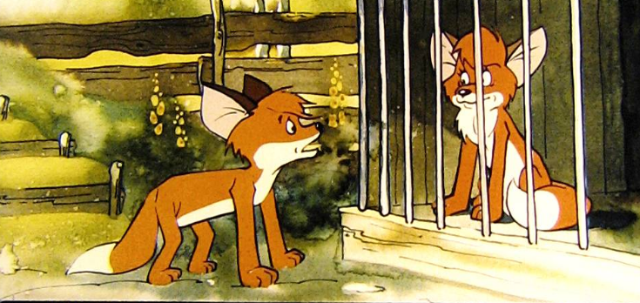
Then he finds a vixen, a young adult fox named Foxy, who is held captive in a cage on a human farm.

Slide 7
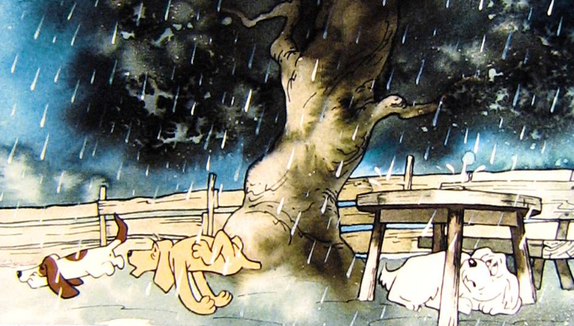
He tricks the guard dogs and other animals, as well as the hunter himself…

Slide 8
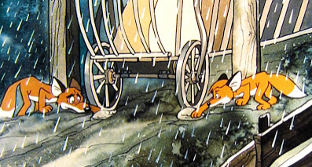
…and eventually helps the vixen escape.

Slide 9
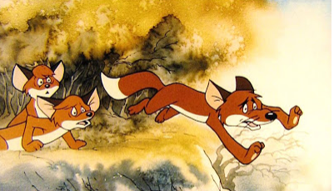
Foxy joins Vuk and Karak in the woods, but Vuk's uncle is shot by humans during a hunt.

Slide 10
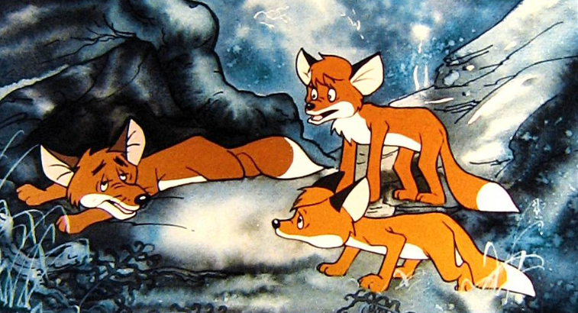
Karak dies and …

Slide 11
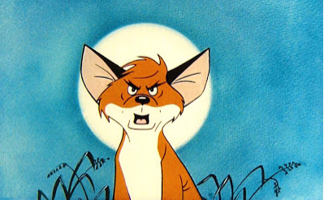
…Vuk swears revenge on the hunter and finally accomplishes it…

Slide 12
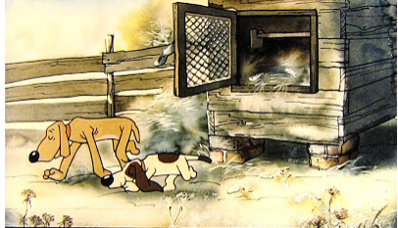
…playing many jokes on the hunter's stupid dogs, killing and devouring the man's livestock and eventually playing tricks on the man himself.

Slide 13
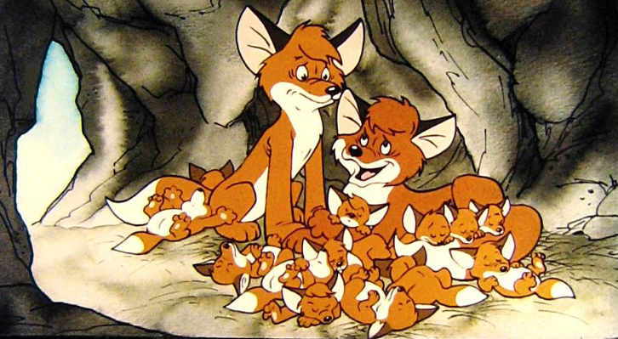
At the end of the film, Vuk and Foxy have cubs of their own.

Slide 14
The English-language dub
Released in the USA
The English dub changes Vuk’s name to „Vic” and his wife’s name to „Foxy”, although Karak’s name remained unchanged.

Slide 15
The famous theme-song of the cartoon

