Slide 1
HAJDU Hajdúsági Ipari Zrt.

Slide 2
About the company
2005. | HAJDU Hajdúsági Iparművek Rt. splits into three different companies.
2001. | Development, beginning of manufacturing and distribution of gas-fired hot water tanks.
1997. | Becoming member of Hungarian National Quality Club. Introducing the environment management system with PHARE-support.
1996. | The beginning of producing components for automotive industry.
1995. | Development and beginning of producing environment-friendly hot water tanks and water heaters. Environment-friendly technological reconstructions to hot water tank production.
1994. | The company gets privatized by Hungarian investors, as HAJDU Hajdúsági Iparművek Rt.
1993. | HAJDU becomes incorporated company.
1957. | The beginning of producing household goods.
1952. | Establishing Hajdúsági Iparművek.

Slide 3
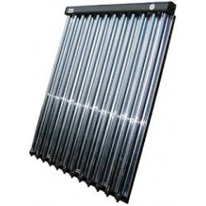
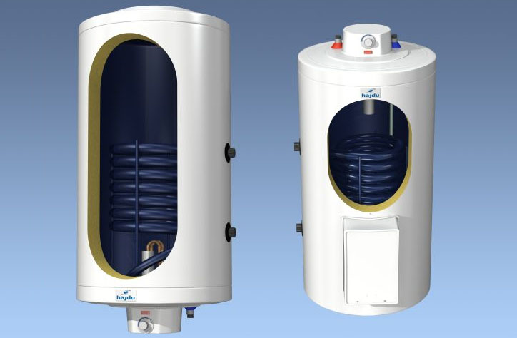
Energy-saving
Since 1996, HAJDU has been producing solar collectors, since 2002 it has been supplying complete solar systems for hot water production and heating assistance.
For the second part of the century, purely HAJDU products can be used to provide a system where heating and hot water is provided by a combi buffer tank that is powered by a pelletized wood-fired boiler or condensing gas boiler and solar collectors for pre-heating the tank.

Slide 4
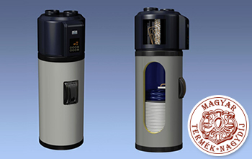
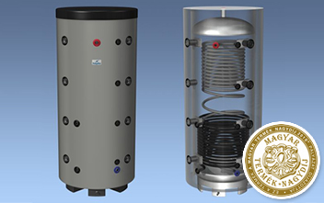
Products
HAJDU Hajdúsági Ipari Zrt. manufactures and sells hot water tanks, water heaters, solar collectors, washing-machines and spin dryers.

